Slide 1

AA ADVISORS
Corporate Presentation
October 2026

Slide 2

AA Advisors is an independent advisory and placement agent focused on private markets and alternatives. Over the past 19 years, the firm has executed 88 raises across private equity, private credit and real assets, with fund sizes ranging from $500 million to $3.5 billion. AA provides primary, secondary, and GP advisory services.
1
AA’s reputation is demonstrated through reappointments by leading institutional managers. Founder & CEO, Alexandra Daly regularly advises the UK Government on private markets topics and has testified before a UK Treasury Select Committee on the role of private markets as investment solutions for UK public pension plans.
2
INTRODUCTION TO
AA ADVISORS
Since 2007, AA Advisors has been deeply embedded in private markets. The firm’s senior distribution professionals average 30 years in finance and 20 years in private-markets fundraising. This gives AA a panoramic view of institutional and wealth appetite and fund design across UK, Switzerland, EMEA, APAC, North America and South America.
3

Slide 3

MEET THE AA GLOBAL TEAM AND NETWORK
We are a seasoned team in raising private market capital at scale across private equity, credit and real assets.
Individual distribution leads focus on select jurisdictions, and we have dedicated marketing resource focused on the consultant universe.

Slide 4
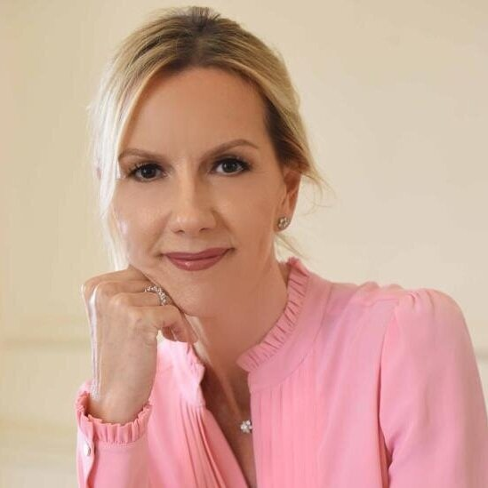
AA’S FOUNDER AND CEO
Alexandra Daly founded AA Advisors in 2007 and has been raising capital in the private markets and alternatives space for the last 25 years, helping raise billions of dollars for an assortment of different General Partners.
Prior to founding AA Advisors, Alexandra worked for the Man Group, where she cross-sold the firm’s multi-manager platforms, fund-of-funds businesses and investment services capabilities to European and UAE institutions, sovereign wealth funds, and family offices. Before this, Alexandra worked at J.P. Morgan in their London office in the derivatives products group. She started her career in finance at Morgan Stanley as a member of the Fixed Income and Money Markets division.
Alexandra holds a BA Honors in Law from City University of London.
Alexandra Daly
Founder and CEO
30+ years experience

Slide 5
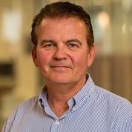
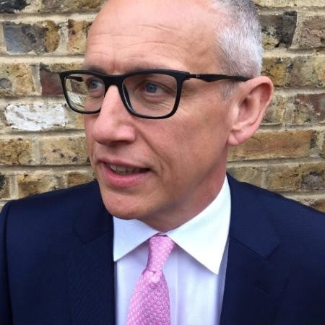
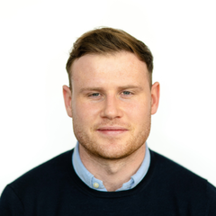
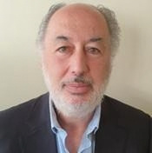
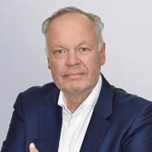
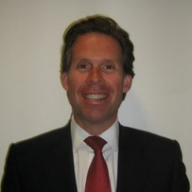
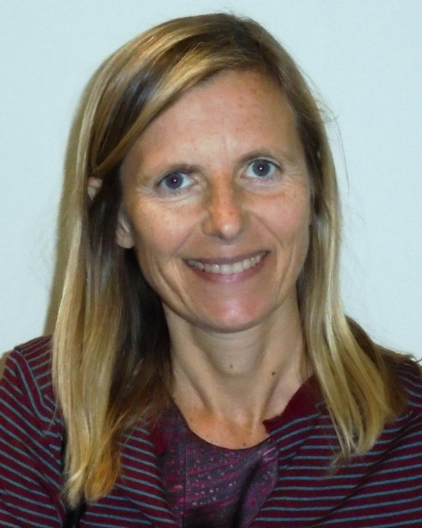
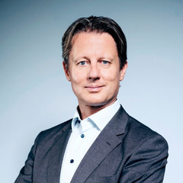
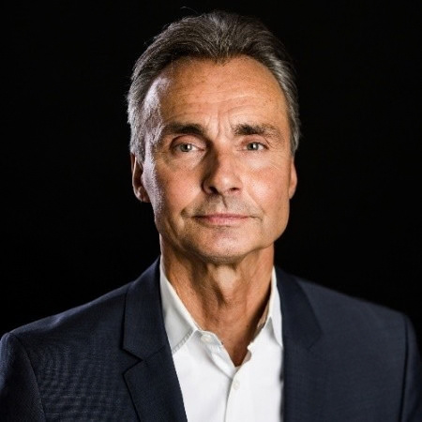
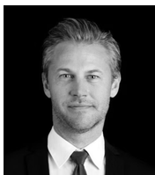
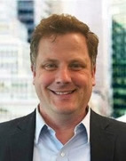
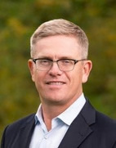
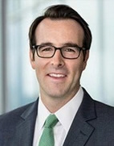

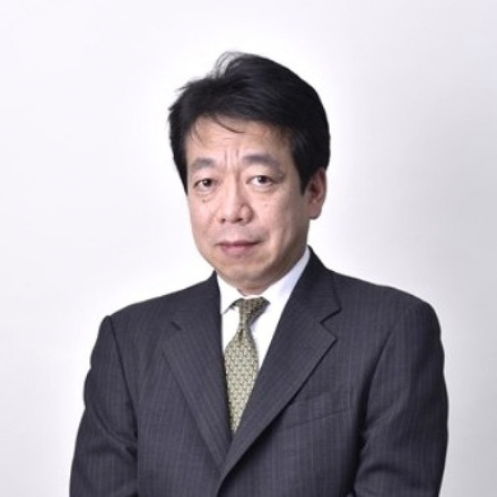
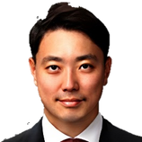
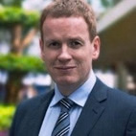
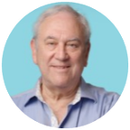
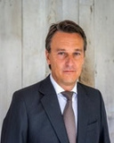
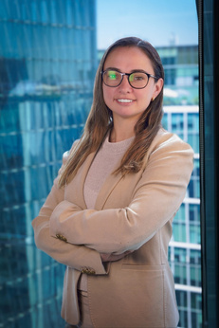
AA Advisors
Marketing Team
m
United Kingdom
Europe
Paul Sullivan
Head of UK Distribution
Richard Pursglove
Cameron Mathewson
Alvaro Pernas
Iberia Distribution
Robert Ekblom
Jeroen Broers
Benelux Distribution
Susanna Invernizzi
UK Distribution
UK Distribution
Nordic & Swiss Distribution
EMEA Distribution
25+ Years Experience
25+ Years Experience
5+ Years Experience
35+ Years Experience
20+ Years Experience
30+ Years Experience
AA US Distribution Partners
30+ Years Experience
Jens Moos
Nordics Distribution
Henrik Bak
Jan Willers
25+ Years Experience
Nordics Distribution
Nordics Distribution
Steve Nelson
Founder, Nelson Group
Eric Perry
Rob Schwab
30+ Years Experience
30+ Years Experience
MD - Nelson Group
MD - Nelson Group
25+ Years Experience
25+ Years Experience
15+ Years Experience
APAC
Israel
Latin America
Rie Kawasaki
Japan Distribution
Soichiro Kuramachi
Japan Distribution
Jaiyong Kye
Korea Distribution
Barry McAlinden APAC Distribution
Aaron Leitner
Alessandro Citterio
Italy & LatAm Distribution
Angélica Armas Sáenz
Chile Distribution
Israel Distribution
15+ Years Experience
30+ Years Experience
20+ Years Experience
35+ Years Experience
25+ Years Experience
15+ Years Experience
20+ Years Experience

Slide 6

PRIVATE CAPITAL FUND
PLACEMENT SERVICES

Slide 7









Sample of Previous Private Equity Mandates
AA Advisors works with private equity managers across a broad range of strategies, including buyout, growth, sector-specialist, special situations and other control and non-control equity strategies. We support both global and regionally focused mandates across Europe, the UK, North America and Asia. Our approach combines detailed assessment of a GP’s track record, portfolio construction, sector expertise and value-creation strategy with AA’s longstanding relationships across institutional investors, family offices and private wealth channels. Since inception, AA has built a deep network of private equity-focused LPs across key global markets, allowing us to tailor distribution by geography, strategy and investor appetite and to position each mandate with the investors most relevant to the opportunity.

Slide 8










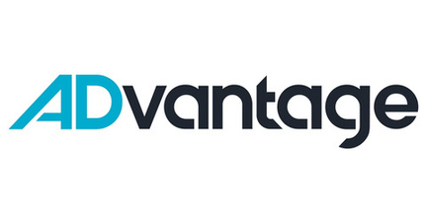


Sample of Previous Growth Equity Mandates
AA Advisors works with growth equity managers investing in established, high-growth businesses across a range of sectors and geographies. We support managers with mandates spanning minority growth investments, expansion capital and later-stage private equity. Our distribution approach is tailored to each manager’s strategy, sector focus, fund size, target returns and geographic exposure, drawing on AA’s global LP relationships and understanding of investor preferences across institutional and private wealth channels.

Slide 9


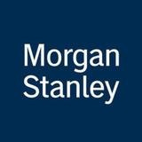







Sample of Previous Private Credit Mandates
AA Advisors works with private credit managers across a broad range of strategies, including direct lending, asset-backed finance, specialty finance, opportunistic credit, structured credit and sector-focused strategies. We look for managers with differentiated sourcing, disciplined underwriting and strong track records, as well as teams with deep specialist expertise. Investor demand for private credit continues to be driven by the search for attractive income, resilient risk-adjusted returns and downside protection, particularly in strategies where managers can demonstrate strong origination capabilities and portfolio discipline.
At the same time, LP appetite is becoming increasingly selective, with greater focus on manager differentiation, deployment visibility, liquidity structure and alignment. AA maintains relationships with institutional and private wealth investors globally and has advised managers across a range of private credit structures, geographies and stages of the fundraising cycle.

Slide 10






Sample of Previous Real Assets Mandates
AA Advisors has a dedicated real assets capability covering infrastructure, real estate, energy transition, natural capital and other asset-backed strategies across both global and country-specific mandates. Our approach is grounded in the intelligence we gather from our global LP network, enabling us to match managers with investors based on mandate fit, allocation priorities and current appetite.
Real assets investors often sit within distinct specialist teams and investment committees, with decision-making structures that differ from those covering private equity or private credit. At the same time, traditional boundaries between infrastructure, real estate, energy and natural capital are becoming increasingly fluid. Institutional investors are taking a more thematic and cross-sector approach to areas such as digital infrastructure, data centres, energy transition, logistics, housing and other essential assets. AA’s coverage reflects this evolution, combining specialist investor relationships with a broader understanding of how real asset allocations are being structured across markets.

Slide 11
PROJECT MANAGEMENT SERVICES
AA recognizes that a tried-and-tested sales infrastructure, process and strong project management are critical to successful fundraising.

Slide 12


CLEAR PROJECT MANAGEMENT GAP IN
PRIVATE MARKETS
The global private markets industry has experienced significant growth over the past decade, with assets under management surpassing $14 trillion—three times what it was ten years ago. This expansion has intensified competition among private market managers, making effective fundraising strategies more crucial than ever
Intensifying Fundraising Competition
Evolving Role of IR and What Good Looks Like
Cross Border Fundraising Needs
Evolving Investor Expectations
Despite a general slow down in private equity fundraising in 2024, with commitments dropping 24% to $1.1 trillion, some firms are poised for significant fundraising efforts in 2025, highlighting a divide in the industry. This competitive landscape necessitates specialized project management to differentiate
In 2025, private markets are
expected to dominate hiring in fund management as firms expand their teams to meet increasing investor demand for private credit, private equity, real estate, and infrastructure. This talent gap underscores the need for dedicated sales project management to support fundraising activities.
As private market managers seek capital beyond their domestic markets, they face diverse regulatory environments and investor preferences. This complexity requires specialized project management to navigate
Investors are increasingly demanding transparency, tailored communication, and strategic engagement. Dedicated sales project management ensures that fundraising efforts align with these evolving expectations, enhancing investor relations and fundraising
cross-border challenges effectively.
and effectively position funds.
success.

Slide 13
KEY PROJECT MANAGEMENT AREAS
What are the different ways that AA works with managers to ensure that they are go to market fit ready to fundraise?
Area 1
Refining fund materials to align with investor expectations and structuring the Virtual Data Room (VDR) for seamless due diligence. Presentations are tailored for different investor segments to ensure clear messaging.
Area 5
Navigating cross-border fundraising requires an understanding of diverse regulatory environments and investor preferences. Ensuring compliance and effective positioning helps managers access global capital.
1
5
Area
2
A structured approach to investor targeting helps prioritize key prospects within institutional and family office networks. Active tracking and pipeline
2
Area 4
Identifying key conferences and speaking opportunities enhances visibility and credibility. Coordinating investor meetings around major events maximizes fundraising efforts.
management ensure timely engagement and follow- ups.
4
Area 3
3
Supporting investor outreach includes scheduling and coordinating meetings, preparing briefing notes, and managing post-meeting follow-ups.

Slide 14
1
Agree on cadence of fundraising goals, target LP profiles, and geographic profiles
AGREE OBJECTIVES
Assess GPs with pace and LP sentiment to determine fund positioning
2
MARKET ANALYSIS
From Advisory to
Distribution
3
COLLATERAL PREP
Prep LP-facing materials, including pitch decks, DDQs and data rooms
10 Step Plan
Position GP unique value proposition and ESG leadership externally
4
BRAND PREP
Identify and prioritize potential investors based on fit, interest, and
strategic goals
5
LP SHORTLIST

Slide 15
6
Agree on cadence of fundraising goals, target LP profiles, and geographic profiles
PRE-MARKETING
Launch a structured and data-driven engagement strategy across target geographies
7
TARGET OUTREACH
From Advisory to
Distribution
Facilitate and support high-impact meetings with LPs, ensuring
alignment and strong narratives
8
MEETINGS CADENCE
10 Step Plan (continued)
Guide LPs through detailed due diligence processes, addressing queries and removing obstacles
9
DD SUPPORT
Close funding rounds and ensure seamless transitions to operational
execution
10
CLOSING

Slide 16
AA TRACK RECORD

Slide 17

Previous Raises & Advisory Mandates
88 Raises Across 19 Years
GP/Manager | Strategy | Duration
Man | Multi Strategy | 2007 – 2008
Man-RMF | Structured Products | 2007 – 2008
Man-Glenwood | Multi Strategy Equities | 2007 – 2008
AHL | Managed Futures, CTA | 2007 – 2008
GLC | Managed Futures | 2009 – 2011
Parker Global | FX, US Special Situations | 2010 – 2013
Quiris Capital | Systematic FX | 2011 – 2012
Acurate | Multi Strategy | 2012 – 2014
Quantica | Managed Futures, CTA | 2012 – 2013
JCI Partners | Discretionary FX | 2012 – 2013
Morgan Stanley | FX Gateway Platform products | 2013 – 2014
Highland Capital Management | PE – Structured Credit | 2013 – 2014
Highland Capital Management | PE – Mid-Market Buyout | 2012 – 2013
Sciens Asset Management | UK Special Situations | 2013 – 2014
Nuveen Investments | Infrastructure Special Situations | 2013 – 2014
Sabre | Managed Futures, CTA | 2014 – 2016
Watamar | Systematic Equities | 2014 – 2015
BGV | Early-Stage Tech (Fund II – IV) | 2014 – 2018
Three Hills Cap Management | PE – Mid-Market Financing | 2015 – 2016
Altis Partners | Managed Futures, | 2014 – 2015
Swiss Life | Real Estate | 2015 – 2015
PE Manager | Private Equity – Secondaries | 2015 – 2016
Lexington Partners | Private Equity – Secondaries | 2016 – 2017
HighGear Ventures | Venture Capital – Secondaries Fund I | 2016 – 2017
Jadeberg Partners | Venture Capital – Tech Scale Up | 2016 – 2017
Sciens Asset Management | Global Special Situations | 2016 – 2017
Stats Investment Manager | Asian HY Bond and L/S Equities | 2017 – 2019
NextGen | Crypto Long Only | 2017 – 2018

Slide 18

Previous Raises & Advisory Mandates
GP/Manager | Strategy | Duration
Bletchly Park | Crypto L/S | 2017 – 2018
NextGen | Blockchain VC | 2017 – 2018
Arena | US PE Mezzanine | 2017 – 2018
Angsana | High Yield Bond Fund (UCITS) | 2017 – 2018
Sciens Asset Management | Private Equity US Infrastructure | Dec 2017 – May 2018
Tikehau Capital | Private Debt | Mar 2018 – June 2018
BGV | VC Early-Stage Fintech – Silicon Valley | Jun 2018 – Dec 2018
WREN | Healthcare Real Estate Private Equity Fund | Oct 2018 – Jan 2019
Cyprium | Private Equity Fund – US Middle Market | May 2018 – Feb 2019
Imagine Capital Group | VC Fintech – Fund I (Europe & Asia) | Sep 2018 – Mar 2019
Murchinson | Special Situations Hedge Fund | Oct 2018 – Mar 2019
AVIV | VC Early-Stage Tech | Nov 2018 – Mar 2019
CADRE | US RE Platform & Direct Access Fund | Nov 2018 – June 2024
Sciens Asset Management | US Private Water Infrastructure Fund | Nov 2018 – Mar 2019
Citibank | Special Situations European Infrastructure Fund | Feb 2019 – Apr 2019
Ginga | Asian L/S Equity | 2016 – 2019
Delgatto Diamond Finance Fund | Private Credit Fund | Apr 2019 – Oct 2019
Illuminate | Fintech VC Fund II | Jun 2019 – Jun 2020
Artesian Impact | Green Bond and Venture Debt Fund I | Jul 2019 – May 2020
Artesian China | China VC Fund I | Oct 2019 – Feb 2020
Pacific Equity Partners | Australian Private Equity Infrastructure Fund | Nov 2019 – Jun 2020
Amadeus Capital Partners | UK Early-Stage Tech VC Fund V | Dec 2019 – Jan 2021
Giant Ventures | Early-Stage Impact Fund I | Jan 2020 – Dec 2020
HighGear Ventures | US Secondary Venture Fund II | Feb 2020 – Aug 2020
ADvantage | Early-Stage VC Sports Tech Fund I | Feb 2020 – Aug 2020
Neoventa | European Growth Capital Fund I | Feb 2020 – Jun 2020
Anthemis | Early-Stage VC Fund I | Mar 2020 – Aug 2020
88 Raises Across 19 Years

Slide 19

Previous Raises & Advisory Mandates
GP/Manager | Strategy | Duration
Anthemis | Insurtech Later Stage Fund I | Mar 2020 – Aug 2020
Holdun | Sport Betting Fund (Open Ended) | May 2020 – Aug 2020
Holdun | US Specialist RE Fund | May 2020 – Aug 2020
Ping An | Asian Green Bond & PE Fund | Aug 2020 – Dec 2021
Helios | African PE Fund IV | Aug 2020 – Nov 2022
Synergy | Special Situations (Private Credit) | Sep 2020 – Aug 2023
Rise Ventures | Brazil Impact Fund I | Nov 2020 – Apr 2021
City Light Ventures | Venture Impact Fund IV | Nov 2020 – Sep 2021
Tetragon | Credit Opportunities IV – CLO Equity | Feb 2021 – Dec 2022
Everberg | US Structured Capital Fund II | Feb 2021 – Jul 2021
Brook Bay Capital | ESG Focused Hedge Fund | Feb 2021 – May 2021
Pharos Capital Group | Private Equity US Healthcare Fund IV | Jun 2021 – Jan 2022
Perwyn | Direct Deals | Jan 2022 – Mar 2022
CQS | Regulatory Capital Relief II | Mar 2022 – Jun 2022
Helios | Climate Fund I | May 2022 – Oct 2022
Finance in Motion | Green Scaler Fund | Aug 2022 – Aug 2023
Cadre | US Real Estate Fund II | Mar 2023 – Jun 2024
Redwing Capital | European PE I | Feb 2022 – Jun 2022
Pollen Street Capital Ltd | Credit III | Jan 2023 – Jun 2023
Finance in Motion | Renewables Growth Fund | Jul 2023 – Jun 2024
Ventura | Technology Growth Fund | Sep 2023 – Jun 2024
NZYME | Small Cap Buyout – Spain | Jun 2024 – August 2025
Ver Capital SGR | Special Situations | Sep 2024 – Sep 2025
88 Raises Across 19 Years

Slide 20
Previous Raises & Advisory Mandates
GP/Manager | Strategy | Duration
Putnam Hill Capital Partners | Private Credit Fund – Direct Lending | Feb 2024 – March 2026
Stellex Capital Management | Fund III – Deep Value PE | Jan 2023 – March 2026
Equita Capital SGR | Direct Lending Fund III | Jan 2025 – January 2026
Lightrock | Energy Access Acceleration Fund (SMA) | Jan 2025 –April 2026
Downing | Downing Private Credit Fund (SMA) | May 2025 – May 2026
Riello Investimenti SGR | B20 Fund IV | May 2025 – May 2026
88 Raises Across 19 Years

Slide 21
Current Raises & Advisory Mandates
GP/Manager | Strategy | Duration
Santander Alternative Investments | Asset Backed Corporate Lending Fund II | Q1 2026 – Q1 2027
RCF | RCF VIII-Commodities | Q1 2026-Present
La Banque Postale Asset Management | Flexible Sub IG Infra Debt Fund | February 2026-February 2027
La Banque Postale Asset Management | Middle Market Direct Lending VII | February 2026-February 2027
Sosteneo Infrastructure Partners (a part of Generali Investments) | Sosteneo Clean Energy Infrastructure Fund II | March 2026-Present
Bond Capital | Bond Fund III | April 2026-Q1 2027
Columna Capital | European Private Equity Fund IV | May 2026-May 2027
Claret Capital | Venture Debt Fund IV (SMA) | September 2026
CenterSquare | CenterSquare Value Add Fund IV & related co-investments (SMA) | September 2026
Tabular Capital | TabCap Balanced Credit Fund (TBAL) | Present
Tabular Capital | TabCap Structured Credit Income Fund (TSCI) | Present
Tabular Capital | TabCap Macro Credit Opportunities Fund (TMAC) | Present
Tabular Capital | TabCap Liquid Credit Income UCITS Fund (TLIQ) | Present

Slide 22
AA TEAM BIOS

Slide 23
EUROPE

Slide 24

ALVARO
PERNAS
SPAIN DISTRIBUTION
Alvaro Pernas began his career at Banco Santander de Negocios in Madrid in 1987 where he ran the Fixed Income Sales desk. He moved to London in 1991 to join the Morgan Stanley Fixed Income Division where he set up and ran the Iberia & Greece Fixed Income sales team (Credit and rates) until 2006 when he left to set up Bretema Capital Advisors. Alvaro joined Marine Capital, a shipping specialist FCA registered fund manager as a partner and Director in 2007 until his departure in 2021. He also held a position as Director in Eclipse Shipping until May 2023.
Alvaro holds a Law Degree and an Economics Degree from the Universidad Pontificia Comillas-ICADE.

Slide 25

ROBERT
EKBLOM
NORDIC AND SWISS DISTRIBUTION
Robert Ekblom has thirty years of experience in Sales and Marketing of Fixed Income Credit Products, Structured Solutions and Alternative Investments to Institutional Investors, Family Offices and Private Wealth Managers. He has been Head of the Nordic Region at Merrill Lynch, Deutsche Bank, Lehman Brothers and RBS Global Markets. He has directly represented asset managers and worked with allocators in Alternative Investments since 2005, and has successfully seeded several new talented mangers, assisted established mangers in growing AUM, and has brought several new concepts and solutions to market.
Robert Ekblom holds a BSc in Economics from the University of Dayton, an MBA in Finance from Stern School of Business at New York University, and Executive Education Diplomas from Harvard Business School.

Slide 26

JEROEN
BROERS
BENELUX DISTRIBUTION
Jeroen Broers is a senior institutional distribution and capital raising professional with 25+ years of experience across private markets, alternatives and traditional asset management.
He has held senior business development and institutional sales roles at Nuveen, Man Group, BlackRock, ING Investment Management and Lehman Brothers, building extensive relationships with institutional investors across the Benelux and wider European markets.
Jeroen brings deep experience in investor coverage, fundraising and strategic client development. He holds an MSc in Economics from Vrije Universiteit Amsterdam and a BBA from Nyenrode Business University.

Slide 27
HENRIK
BAK
NORDICS DISTRIBUTION
Henrik Bak is a senior investment management and institutional distribution professional with more than four decades of experience across the Nordic and international markets. He previously served as Head of Clients and Institutional Business at Danske Bank/Danske Capital and held a number of senior leadership roles at Nordea Investment Management and Nordea Securities, including nine years as President and CEO of their US businesses in New York. Since 2017, he has worked as an independent adviser and board member to a number of Danish and international asset managers, bringing extensive experience in institutional client relationships, business development and investment management. He is based in Copenhagen.

Slide 28

JENS
MOOS
NORDICS DISTRIBUTION
Jens Moos is a senior investment management and client relations professional with more than 25 years of experience across portfolio management, manager selection, institutional relationships and business development. He spent 13 years as Chief Portfolio Manager at Danske Bank Asset Management, where he led a team managing more than €40 billion across multi-asset client solutions in six countries and served on several investment committees. Earlier in his career, he held portfolio management roles at Nykredit Group Treasury and has also gained experience within fintech and ESG. Jens is currently a Business Introducer at House of Reach, supporting asset managers with business development and investor relationships across the Nordic market. He is based in Copenhagen and holds an MSc in Mathematics and Economics from the University of Copenhagen.

Slide 29

JAN
WILLERS
NORDICS DISTRIBUTION
Jan has 19 years of experience in the financial industry, working with industry stakeholders in the Nordics and helping asset managers implement their strategy and grow their business in the Nordics.
​Before joining House of Reach, Jan spend almost 20 years at Copenhagen based consultant Kirstein. Here he led a team of 15 employees successfully surveying investors in the Nordic region in order to understand the needs of the institutional investors. Jan combine strategic advisory and business development through his deep insight into the asset management industry based on his many years of research of the behavior and the needs of investors. Jan is responsible for institutional business development activities in Denmark, Norway and Iceland. Jan holds a M.Sc. in Economics

Slide 30

SUSANNA
INVERNIZZI
EMEA DISTRIBUTION
Susanna Invernizzi is a senior investment professional with over 30 years of experience in financial advisory and asset management, specializing in global energy, utilities, and infrastructure. As a former Managing Director at Morgan Stanley, she managed a €3bn global infrastructure fund, where she was responsible for strategic asset allocation, investment selection, and risk management.
Currently a Senior Executive Fellow at SDA Bocconi, Susanna lectures focus on Investment Management, and Infra Financing. She also serves on the Advisory Board of the Global Listed Infrastructure Organisation (GLIO). She holds a degree Summa Cum Laude from Bocconi University and a CEMS Master’s from HEC Paris.

Slide 31
UK

Slide 32

PAUL
SULLIVAN
UK & CANADA INSTITUTIONAL DISTRIBUTION
Paul Sullivan is an experienced fundraiser in the European Private Credit Markets. He was most recently a Director in Global Capital Markets at Funding Circle plc where he managed the private and public Funds businesses, built relationships with UK pension funds and insurance companies and raised capital for SME lending. Prior to this, he was a Partner and Head of Business Development at Pemberton Asset Management where he was instrumental in the raising of Pemberton Fund I of €1.2B (European Mid-Market Direct Lending). Over his 32 years in London, Paul has developed strong and longstanding investment relationships with most of the leading UK insurance companies and pension funds. Paul has raised money for commingled private credit funds and several large separately managed accounts for European insurers and UK Pension Funds. He has been involved in fund structuring, currency hedging, balance sheet management, loan loss provisioning, dividend/distribution policy and all aspects of financial reporting to investors. Paul has a BA in Economics from the University of Michigan where he majored in International Finance and Trade Theory and an MBA from Northeastern University in Corporate Finance where he attended as a Graduate Teaching Assistant.

Slide 33
RICHARD
PURSGLOVE
UK WEALTH DISTRIBUTION
Richard Pursglove is a senior asset and wealth management distribution professional with more than 30 years of experience across institutional, wholesale and wealth channels. He began his career as a financial adviser before moving into asset management, where he has held senior sales and distribution leadership roles at Cazenove Capital, Gartmore, Goldman Sachs Asset Management, Artemis Investment Management and Aberdeen Standard Investments.
Richard subsequently served as Head of Distribution at Sanlam UK, with responsibility for sales and marketing strategy, and most recently held a senior investment solutions and distribution role at Hawksmoor Investment Management. His experience spans distribution strategy, client engagement and business development across a broad range of investor groups and investment products.

Slide 34
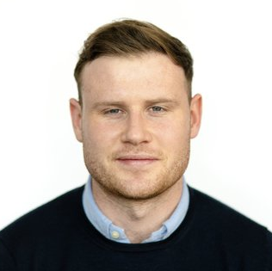
CAMERON
MATHEWSON
UK DISTRIBUTION
Cameron supports investor relations as well as senior sales across business mandates. Cameron holds a Bachelor’s and Master’s degree in Finance from The George Washington University in DC. Post graduation he gained experience at Clarity BidRate a carbon credits platform, and at SEI Investments in junior analyst roles.

Slide 35
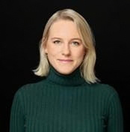
JOANNA
CHAYTOR
COO
Joanna Koczuk is a senior private markets fundraising and distribution executive with 12 years of experience across institutional capital raising, investor relations and strategic business development For the past three years, Joanna has worked with AA Advisors across institutional fundraising mandates, advising private markets managers on capital-raising strategy, investor positioning, market coverage and global LP engagement.
Previously, Joanna held senior investor relations and fundraising roles at Oxx, Picus Capital and Phoenix Group. Earlier in her career, she spent several years helping to build the private markets distribution platform at Schroders Capital, working across institutional sales, new client acquisition, cross-selling and strategic growth initiatives ahead of the platform's strategic sale to Nuveen. Joanna began her career in alternatives at PAAMCO in the United States, giving her a longstanding foundation in institutional alternative investments and manager relationships.
Joanna holds a Bachelor’s degree from Harvard University and an MBA from Imperial College Business School.

Slide 36

HANAH
OVENSTONE
INVESTOR RELATIONS
Hanah is responsible for investor relations and runs project administration alongside interfacing with AA Advisors general partner clients.

Slide 37
APAC

Slide 38
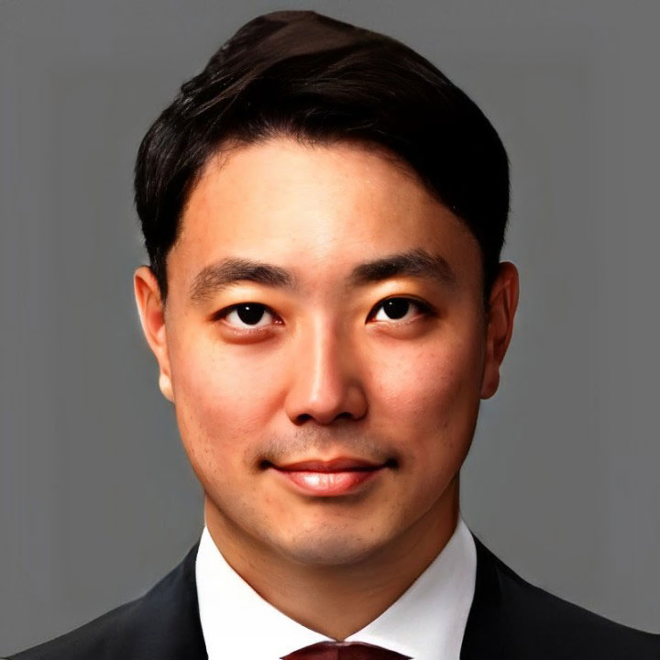
JAIYONG
KYE
KOREA DISTRIBUTION-KYE& INVESTMENT
Previously, Jaiyong Kye has years of professional finance experience in strategic investment and capital raising. He is a Founder and Managing Partner at Kye& Investment, established in 2015. Before found Kye& |nvestment, he was a pivotal figure at KDB Daewoo Securities, holding the position of Managing Director where he spearheaded overseas business development and strategic investment, particularly in the United States, liaising directly with CFOs and CIOs of top-tier global investment firms, including Starwood Capital, Greenhill, Moelis, Stifel and Tudor, Pickering, Holt & Co., among others.
With 30 years or rich experience in cross-border M&A and corporate finance, Jaiyong has a proven track record of advising financial institutions and corporations across the globe. His expertise was honed through significant roles at renowned firms including HSBC Investment Bank, Meritz Securities and Daewoo Securities.
Jaiyong’s academic credentials include an MBA from the Simon Business School at the University of Rochester and a B.A. in Economics from Dongguk University.

Slide 39

BARRY
MCALINDEN
APAC (EX KOREA & JAPAN) DISTRIBUTION
Barry is a seasoned finance professional with extensive experience in capital raising, business development, and equity research. Currently, at Conduit Group, specializing in capital raising and strategic business development. Previously, he served as Managing Director at CapConnect, where he facilitated investment opportunities and strengthened client relationships. His expertise in financial research and compliance was further demonstrated as Business Development Director at ERIC On-Line, a MiFID II-compliant platform designed for institutional research users.
Before that he was a Director at Panoptic Europe Limited advising on securities and corporate access, focusing on bottom-up analysis of Continental European companies. His career in equity sales includes key positions at Standard Chartered, CLSA, Deutsche Bank, where he provided institutional clients with critical market insights and investment strategies. He began his career as an Audit Manager at Ernst & Young developing a strong foundation in financial analysis and risk assessment.

Slide 40
RIE
KAWASAKI
JAPAN DISTRIBUTION-CROSSPOINT ADVISORS
Rie Kawasaki is a senior investment and financial markets professional with more than 20 years of experience across institutional asset management, fixed income and capital markets in Japan.
Rie is currently a Managing Director at Crosspoint Advisors in Tokyo. Prior to joining Crosspoint in 2022, she spent 15 years at Morgan Stanley Investment Management as a member of the Global Fixed Income Investment Team, developing extensive experience working within a leading global institutional investment platform. She began her career in Debt Capital Markets at Merrill Lynch.
Rie brings deep knowledge of the Japanese institutional market and a longstanding perspective on global investment strategies and investor requirements. She holds a B.A. in Political Science and Law from Keio University.

Slide 41
SOICHIRO
KURAMACHI
JAPAN DISTRIBUTION-CROSSPOINT ADVISORS
Soichiro Kuramachi is a senior investment and alternatives professional with nearly 40 years of experience across institutional asset management, private markets, fixed income and investment product development in Japan and internationally. He is currently a Managing Director at Crosspoint Advisors, where he focuses on alternative investments including private credit, private equity, venture capital and infrastructure. Prior to joining Crosspoint, Soichiro spent almost five years at Invesco Asset Management Japan, leading the promotion of private credit strategies to institutional investors across areas including direct lending, leveraged loans, distressed debt and CLOs. Earlier in his career, Soichiro held senior leadership positions at BNP Paribas Asset Management, PGIM Japan, Nomura and Mizuho-affiliated investment businesses. His experience has included institutional investment management, alternative fund selection, product development, client coverage and the management of investment teams in Japan, the United States and the United Kingdom.
Soichiro is a CFA charterholder and holds a degree from the University of Tokyo.

Slide 42
NORTH AMERICA

Slide 43
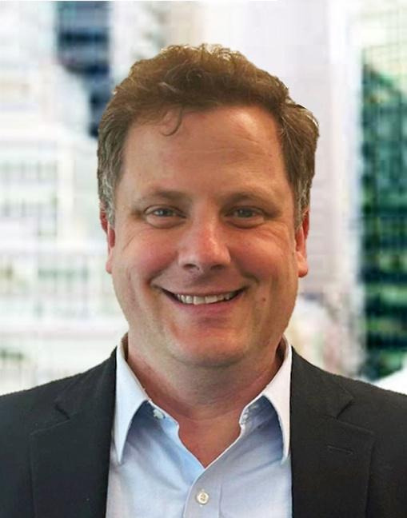
STEVE
NELSON
FOUNDER NELSON GROUP – US DISTRIBUTION PARTNER
Steve Nelson founded The Nelson Group in 2020 with a vision to provide capital formation and consultation for emerging and niche asset managers. With nearly 20 years of experience, Steve’s network of relationships extends deeply into the institutional, family office, and RIA space, offering The Nelson Group a unique advantage in connecting with a diverse array of clients. Steve’s extensive connections within the ultra-high-net-worth (“UHNW”) sector and RIA space specifically enhance the firm’s ability to navigate these specialized domains.
Steve brings his investor relationships and knowledge of structuring vehicles for family offices and HNW investors to help Shelter Rock navigate the environment on behalf of its clients. Previously, Steve served as Managing Director at Magnetar Capital, a leading alternative asset manager specializing in fixed-income energy, quantitative, and event-driven strategies. Steve also contributed to the investor relations team at Och-Ziff and gained valuable investment experience at SCS Financial and Alternative Investment Partners (AIP). Steve received his BA in Economics from Hamilton College, where he was a member of the varsity basketball team.

Slide 44

ERIC
PERRY
MD NELSON GROUP – US DISTRIBUTION PARTNER
Eric Perry has over 25 years of experience, primarily focused on business development and investor relations. Eric brings his extensive network of investor relationships, which focuses on the UHNW, family office and institutional space, as well as capital formation expertise for drawdown and evergreen structures. Previously, Eric served as a Managing Director on Varde Partners’ business development team for eight years, where he played a pivotal role in building new client relationships across institutional and family office investors in North America, the Middle East, and Australia.
Eric also partnered with former Varde colleagues to launch Hyland Hill, and alternative credit investment firm, where he and his partners successfully raised their first institutional fund, Prior to Varde and Hyland Hill, Eric was a Senior Vice President in Business Development at Mesirow Financial and spent two years in Abu Dhabi as part of a joint venture with Mubadala, a United Arab Emirates investment company. Eric also spent some time on the business development team at UBS. Eric received his BA in Geography and Economics from St. Cloud State University.

Slide 45

ROB
SCHWAB
MD NELSON GROUP – US DISTRIBUTION PARTNER
Rob Schwab brings over 15 years of experience spanning hedge funds, credit, and private investments. Over the course of his career, Rob has built an extensive network of relationships with institutional and UHNW investors.
Previously, Rob served as the head of IR & Marketing at Anchor Bolt Capital and was a member of the IR & Marketing team at Och-Ziff Capital Management. Rob also spent time at Hatteras Funds, Goldman Sachs, and Putnam Investments. Additional information about Rob may be found at FINRA’s Broker Check.
Rob received his BA in Political Science from the College of the Holy Cross and is a CAIA charter holder.

Slide 46
LATIN AMERICA

Slide 47
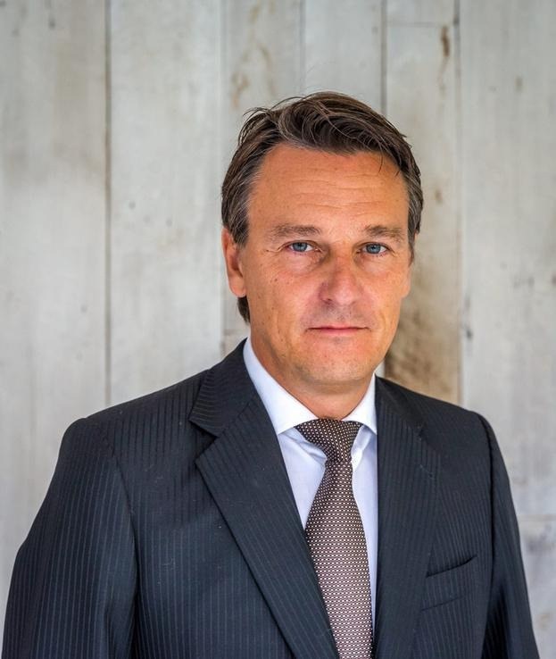
ALESSANDRO
CITTERIO
LATIN AMERICA & ITALY DISTRIBUTION
Alessandro Citterio is an experienced investment professional with over 30 years across asset management, fund distribution, and capital markets in Europe and Latin America. He began his career in London with roles at Goldman Sachs, Credit Suisse, Nomura, and Bankers Trust, before transitioning into hedge fund management and launching the London office of Unifortune Investment Management.
In 2007, Alessandro moved to Chile, where he founded the hedge fund arm of LarrainVial and later co-founded Lanin Partners, managing Latin American equity strategies. As CEO and Partner of Azimut Investments AGF, he led the firm’s institutional distribution across seven Latin American countries, engaging with over 200 institutional clients. He currently serves as Head of International Distribution at Frontal Trust in Madrid, focusing on private assets and club deals across infrastructure, farmland, and private credit. Alessandro holds an MSc from the London School of Economics and a cum laude degree from Bocconi University. He is fluent in six languages.

Slide 48

ANGÉLICA
SÁENZ
CHILE DISTRIBUTION
María Angélica Armas Sáenz is a Chilean finance and investment executive with over a decade of experience in private equity, corporate investments, and strategic financial leadership.
She currently serves as CFO of Inversiones Wivet SpA, Chile and Colombia's largest veterinary clinic network, part of the Stars Companies group. In this role, she leads financial strategy, budget management, investor relations, and risk management, while also sitting on investment oversight committees across multiple international private equity funds.
Prior to these roles, she spent nearly a decade at Stars Investments, the investment vehicle of the Ibáñez Atkinson family, rising from Analyst to Vice President of Corporate Investments. There she managed a global private equity portfolio of 110+ funds across the US and Europe, led co-investment strategies, and held observer board seats at Waterfleet and Jetti Resources (USA). Angélica holds an International MBA from IE Business School (Madrid) and a degree in Commercial Engineering from Pontificia Universidad Católica de Chile.

Slide 49
ISRAEL

Slide 50
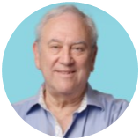
AARON
LEITNER
ISRAEL DISTRIBUTION
Aaron Leitner is a seasoned institutional investment professional with 39 years of experience spanning global markets, portfolio management, and institutional client services. He began his career on Wall Street in 1986 as a Financial Consultant with Shearson Lehman Brothers, later becoming a Portfolio Manager at Prudential Securities before returning to Israel in 1995. From 1995, he served as Global Portfolio Manager for Bank Hapoalim’s Provident Funds Group, overseeing assets for one of Israel’s premier investment institutions. He subsequently joined Robertson Stephens Evergreen as Head of Institutional Sales & Service and later moved to Lehman Brothers’ Israel Investment Management Services, where he worked with institutional, private banking, corporate, and venture capital clients. Prior to joining Tandem Capital in March 2005, Aaron served as Executive Vice President at Financial Guardian, Israel’s first multi-family office. Aaron holds a Bachelor of Arts from Rutgers University. He was Series 7, 63, 65, and FSA licensed in the United States and the U.K. and is a licensed Investment Portfolio Manager with the Israel Securities Authority.

Slide 51
LEGAL & COMPLIANCE

Slide 52
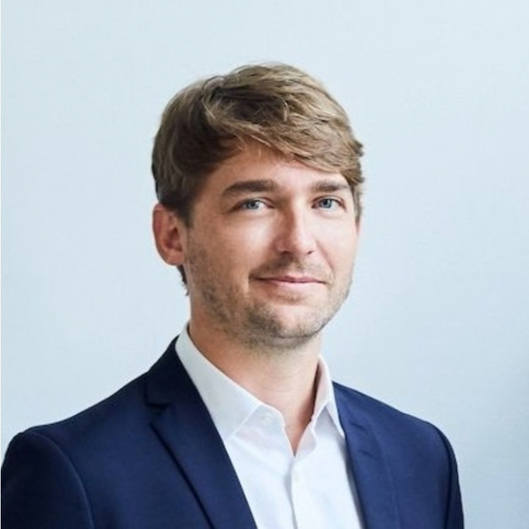
TILL
TOLKSDORF
EUROPEAN COMPLIANCE
Till Tolksdorf is a senior regulatory and compliance professional with 15 years of experience across banking, alternative investments and European financial regulation.
He is Managing Director of Nemos Regulatory Solutions, where he advises asset managers and placement firms on regulated distribution and cross-border fundraising across Europe. Till has nine years of regulatory responsibility under the FCA and four years under BaFin, with particular expertise in European fund marketing and distribution requirements.
Previously, he was Managing Director and Partner at Arbour Partners and held senior roles at ProCredit Bank. He brings extensive experience navigating the regulatory requirements associated with institutional fundraising across European markets.

Slide 53
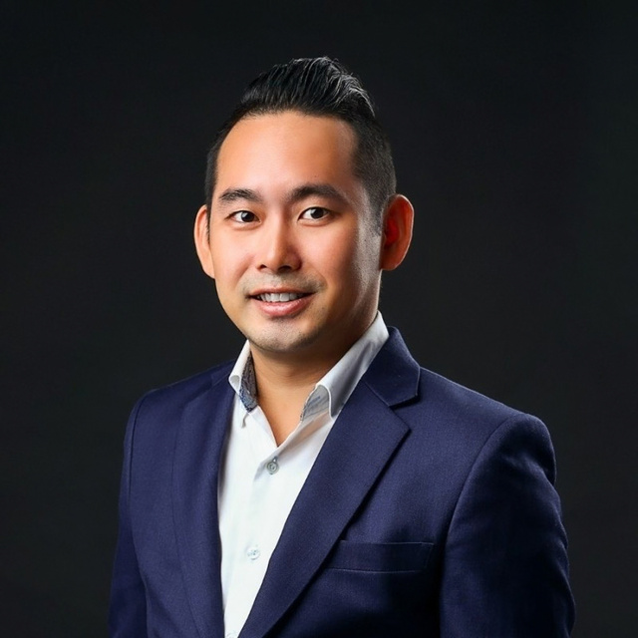
CHONG SIAN
LIM
APAC COMPLIANCE
Chong Sian Lim is a senior regulatory and compliance professional with extensive experience across financial services, governance, risk management and financial crime compliance in Singapore.
He is currently Head of Compliance at Conduit Group, where he is responsible for regulatory compliance across the Group’s two MAS-licensed entities. His expertise spans regulatory compliance, AML/CFT, governance and risk, supporting the distribution and management of investment products within Singapore’s regulated financial services market.
Chong Sian is a Certified Anti-Money Laundering Specialist (CAMS), an IBF Advanced-certified compliance professional and holds qualifications in regulatory compliance and governance, risk and compliance from the International Compliance Association.

Slide 54
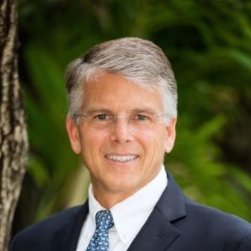
GEOFFREY
WEBSTER
US COMPLIANCE
Geoffrey Webster is a senior financial services executive with more than 30 years of experience across broker-dealer operations, compliance, finance, sales and trading.
He is Co-Founder and Chief Compliance Officer of Castle Hill Capital Partners, where he built and oversees the firm’s broker-dealer infrastructure across compliance, operations and finance, supporting capital raising and private placement activity across alternative investment strategies.
Previously, Geoffrey held leadership roles at Morgan Stanley and Goldman Sachs, supporting institutional clients, trading businesses and operational functions. He holds a B.S. in Finance from Bentley University and multiple FINRA registrations, including Series 7, 24, 27 and 79

Slide 55

GERRY
MORGAN
UK COMPLIANCE
Gerry Morgan is a senior compliance and financial services professional with more than 20 years of experience across regulatory compliance, management consulting and accountancy. He is a Director at City Capital Consulting, where he advises financial services firms on FCA regulatory requirements, compliance frameworks and business operations. Gerry also supports regulated investment managers on governance and ongoing compliance matters

Slide 56
DISCLAIMERS
Regulation
AA Advisors Europe Limited is Registered in England, Company Number 07681716. AA Advisors is an FCA registered and regulated
leading placement agent in the alternatives industry assisting firms through their distribution cycle.
Exclusion of activities
AA Advisors is a placement agent of investment funds and related services around the world. Such activities are always limited to introduction, product promotion, relationship, and marketing. They exclude reception and transmission of fund orders, holding client cash or securities, underwriting of securities issues and providing legal, tax and accounting advice. Its activities are dedicated exclusively to professional or qualified or accredited investors, as defined in the different jurisdictions in which AA Advisors operates. AA Advisors does not offer its services to retail investors, unless they want to opt for professional investor status and satisfy the conditions set by the law.
Conditions of access
Information contained on the present site are disclosed for information purposes exclusively. They do not aim at soliciting in any
manner nor at offering the subscription or sale of securities. The presentation presents the activities of AA Advisors as well as the characteristics of the services which the company offers in several distinct jurisdictions. It belongs to the person who consults it to make sure that the regulation which is applicable to him/her does not prohibit him to subscribe the products or services subjected to other jurisdictions laws and regulations. The access to the products and services being reproduced on the site, if any, can be subject to restrictions with regard to certain investors or countries, either under the terms of general prohibitions, or under the terms of rules of marketing by asset managers and their agents. Consequently, no information on products or services presented on the site will be provided by AA Advisors to a person if it is aware that the law which is applicable to him/her prohibits it.

